Slide 1

Together Building A Better District

Slide 2

UGU DISTRICT MUNICIPALITY PERFORMANCE MANAGEMENT REVIEW
2015/2016
QUARTER FOUR PERFORMANCE ANALYSIS REPORT
11 JULY 2016

Slide 3
PRESENTATION OVERVIEW
PURPOSE AND BACKGROUND OF THE REPORT
KEY PERFORMANCE AREAS
REPORTING METHODOLOGY
DEPARTMENTAL PERFORMANCE
OVERALL ORGANISATIONAL PERFORMANCE
ELEVATION OF PMS

Slide 4
1. PURPOSE AND BACKGROUND
Purpose
To provide performance analysis for the mid-year review for 2015/2016
To identify early warning signs where targets are not going to be achieved and areas of delivery lagging behind
To evaluate the quality of the actual results delivered by programmes in the attainment of strategic objectives
To provoke recommendations and suggestions for service delivery improvement
To ensure accountability between the administration; political component and the public
Promotes a culture of performance
Support municipal oversight
Promote Developmental Local Government
Facilitates decision making to allow for efficient and effective allocation of resources

Slide 5
Background
SDBIP serves as a contract between administration, Council and community set by Council as quantifiable outcomes to be implemented over 12 months.
It provides vital link between the Mayor, EXCO and administration and facilitates the process for holding management accountable for its performance
It is the management, implementation and monitoring tool which sets in-year, quarterly service delivery and monthly budget targets and links each service delivery output to the budget of the municipality
SDBIP is politically driven and managed by EXCO
Milestones achieved to date
2015/2016 SDBIP approved within legislative framework prescription- 27 June 2015
2015/2016 SDBIP published within 14 days of approval
Performance agreements for S54 and 56 were signed on 31 July 2015
Performance report together with the draft 2014/2015 was submitted to AG on 29 August 2015
The first three quarters 2015/2016 quarterly reviews were held on time
PMS received unqualified audit opinion.
Quarter 01 S56 and 57 evaluations were done on 07 November 2015
Mid-year review held on 25 January 2016
2014/2015 annual assessments and Mid year S57 assessments done on 15 March 2016
2014/2015 Annual and Oversight Report was adopted on 24 March 2016

Slide 6
2. KEY PERFORMANCE AREAS
1. Municipal Transformation and Institutional Development
Performance Management System
Human Resources Development And Management
Legal Services
Secretariat and Auxiliary services
Information Communication Technology (ITC)
Fleet Management
Occupational Health And Safety
2. Local Economic Development
Local Economic Development
Job Creation
Poverty Alleviation
Economic sector development
Improvement of community socio-economic conditions
Creation of an enabling environment for business investment and thriving
Economic Research and Development

Slide 7
2. KEY PERFORMANCE AREAS
3. Basic Service Delivery
Provision and management of Water And Sanitation
Water And Sanitation Infrastructure development and Maintenance
Provision of Free Basic Services
4. Good Governance and Community Participation
Internal Audit And Risk Management
Community Participation
Mayoralty And Communication
Intergovernmental Relations
Special Programmes
Youth Development
HIV And AIDS

Slide 8
2. KEY PERFORMANCE AREAS
5. Municipal Financial Viability and Management
Municipal budget management
Municipal Revenue Collection and Expenditure Management
Municipal Assets Management
Municipal Supply Chain management
Cross-cutting Intervention
Development, Statutory and Strategic Planning
Environmental Management
Disaster Management and services

Slide 9
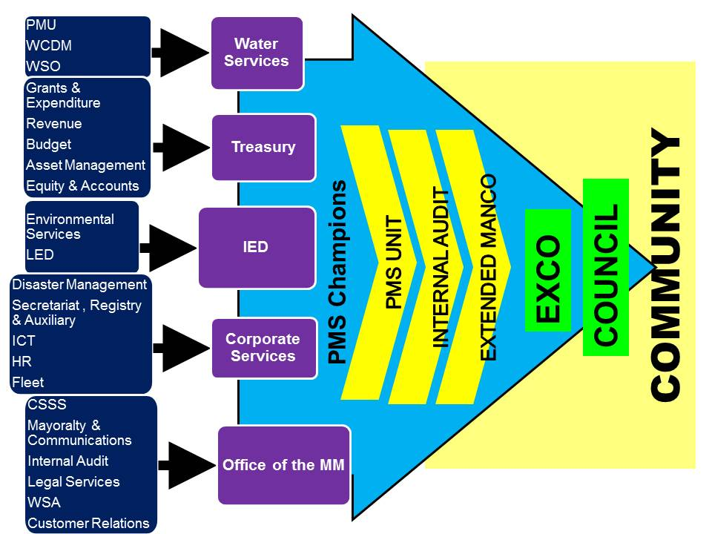
3. REPORTING METHODOLOGY

Slide 10
DEPARTMENTAL PERFORMANCE: 2015/2016 –QUARTER 4
PMS Quarter 4 Analysis
Department | Total Targets reported Q4 |  | Achieved Targets |  | Non Achieved Targets
 | No | % | No | % | No | %
Water Services (Unaudited) | 11 | 100 | 9 | 82 | 2 | 18
IED (Unaudited) | 62 | 100 | 55 | 89 | 7 | 11
Corporate Services | 83 | 100 | 80 | 96 | 3 | 4
Treasury | 44 | 100 | 34 | 77 | 10 | 23
OMM | 107 | 100 | 99 | 93 | 8 | 7
Ugu SC Tourism | 69 | 100 | 69 | 100 | 0 | 0
Ugu SC Devpt. Agency | 31 | 100 | 20 | 65 | 11 | 35
Total | 407 | 100 | 366 | 90 | 41 | 10

Slide 11
2015/2016 DEPARTMENTAL PERFORMANCE COMPARISON: 1st TO 4th QUARTERS

Slide 12
2015/2016 ORGANISATIONAL PERFORMANCE COMPARISON FROM QUARTER 1 TO QUARTER 4

Slide 13
Siyabonga
Enkosi
Thank you

